Slide 1
EMERSE and Natural Language Processing
in clinical practice
EMERSE 和自然语言处理在临床中的应用
November 11, 2023
David Hanauer, MD, MS
Dept of Learning Health Sciences
University of Michigan, USA
hanauer@umich.edu
Twitter: @informaticsGeek
@projectEMERSE
Web: project-emerse.org
http://project-emerse.org/presentations.html

Slide 2
If you’re thinking of taking notes
or want to visit links
these slides can be found at:
this link will be
on most slides
http://project-emerse.org/presentations.html

Slide 3
Disclosures
Funding: NIH (NCI, NCATS)
U of Michigan Licenses: EMERSE “Synonyms”
Disclosures
http://project-emerse.org/presentations.html

Slide 4
http://project-emerse.org/presentations.html

Slide 5
2021 University of California–Irvine study: Design, Implementation, and Usability of the Electronic Medical Record Search Engine (EMERSE) Tool
“Users unanimously responded that they would recommend the system to others, and…for a tool they found so useful, they believed that far too few people both within and outside of their network knew about the tool’s existence.”
https://escholarship.org/uc/item/44p23878
http://project-emerse.org/presentations.html

Slide 6
Unstructured vs Structured Data
EMERSE is for this… | …not this
Unstructured Data (free text) | Structured Data
Mr. Lee is a 56 year old male with a history of HTN, hypercholesterolemia, and T2DM who comes to the clinic today with a 3 day h/o dizziness and severe headache on the left side. | WBC: 5.6 Total cholesterol: 182 Weight: 67.4 AST: 30 ALT: 52
http://project-emerse.org/presentations.html

Slide 7
80% of EHR data are in unstructured free text
structured data
unstructured data/free text
http://project-emerse.org/presentations.html

Slide 8
The EMERSE solution
A system “for the people”
Users search the notes on their own
No need to wait in a queue for an analyst or a data scientist
Easy-to-use for non-technical researchers
Doesn’t over-promise: user interaction is required
http://project-emerse.org/presentations.html

Slide 9
The EMERSE solution
A system “for the admins”
Enterprise grade, easy to support
Configurable with roles/privileges to control access
Data are kept secure within a centralized, audited system
No need to download/store the data elsewhere
http://project-emerse.org/presentations.html

Slide 10
Find cohorts
EMERSE allows you to find cohorts based on things mentioned in the notes
diseases
drugs
symptoms
anything*
*if it is mentioned
http://project-emerse.org/presentations.html

Slide 11
Find cohorts
It’s perfect for finding rare things…
…like rare cancers
See this talk for more details:
https://vimeo.com/677482835
“Using EMERSE to Improve Research Involving Rare Cancers”
http://project-emerse.org/presentations.html

Slide 12
Highlight documents for chart review
Thoracocentesis confirmed the recurrence of mantle cell lymphoma. Disease restaging work-up revealed multicompartment lymphadenopathy in the neck, mediastinal, retrocrural, retroperitoneal and pelvic regions. Bone marrow was also involved. The patient was treated with a total of six cycles of rituximab, cyclophosphamide, vincristine, doxorubicin and dexamethasone (R-HyperCVAD) completed in January 2007. That treatment led to complete remission that lasted until October 2008, when the disease was found to have recurred in the left pleural space and retroperitoneum without bone marrow involvement.
https://jmedicalcasereports.biomedcentral.com/articles/10.1186/1752-1947-4-329
http://project-emerse.org/presentations.html

Slide 13
Our philosophy
It’s important to see the terms/concepts in the context of the original text to truly understand the clinical meaning.
http://project-emerse.org/presentations.html

Slide 14
Meta Mapping (1000):
1000 *^patient (Patients) [Patient or Disabled Group]
Meta Mapping (702):
742 Presented (Presentation) [Idea or Concept]
742 PALPABLE (Palpable) [Qualitative Concept]
784 right Breast mass (Lump in right breast) [Finding]
Meta Mapping (1000):
1000 Clinical Laboratory (Clinical Laboratory Services) [Health Care Activity]
Meta Mapping (1000):
1000 Clinical Laboratory (Laboratories, Clinical) [Health Care Related Organization,Manufactured Object]
Meta Mapping (947):
947 Mammography finding [Finding]
Meta Mapping (743):
715 CARCINOMA OF BREAST (Breast Carcinoma) [Neoplastic Process]
Meta Mapping (1000):
1000 *^patient (Patients) [Patient or Disabled Group]
Meta Mapping (1000):
1000 LUMPECTOMY (Lumpectomy of breast) [Therapeutic or Preventive Procedure]
Meta Mapping (1000):
1000 SENTINEL LYMPH NODE BIOPSY (Sentinel Lymph Node Biopsy) [Diagnostic Procedure]
Meta Mapping (745):
806 Frozen Section (Frozen Sections) [Tissue]
593 Tumour (Neoplasms) [Neoplastic Process]
Meta Mapping (745):
806 Frozen Section (Frozen Sections) [Tissue]
593 Tumor (Tumor tissue sample) [Tissue]
Meta Mapping (745):
806 Frozen Section (Frozen Sections) [Tissue]
593 Tumor (Specimen Source Codes - tumor) [Intellectual Product]
Meta Mapping (745):
806 Frozen Section (Frozen Sections) [Tissue]
593 Tumor (Tumor Mass) [Finding]
Meta Mapping (745):
806 Frozen Section (Cryoultramicrotomy) [Laboratory Procedure]
593 Tumour (Neoplasms) [Neoplastic Process]
Meta Mapping (745):
806 Frozen Section (Cryoultramicrotomy) [Laboratory Procedure]
593 Tumor (Tumor tissue sample) [Tissue]
Meta Mapping (745):
806 Frozen Section (Cryoultramicrotomy) [Laboratory Procedure]
593 Tumor (Specimen Source Codes - tumor) [Intellectual Product]
Meta Mapping (745):
806 Frozen Section (Cryoultramicrotomy) [Laboratory Procedure]
593 Tumor (Tumor Mass) [Finding]
Meta Mapping (1000):
1000 Sentinel node (Sentinel node (disorder)) [Disease or Syndrome]
Meta Mapping (1000):
1000 Sentinel Node (Sentinel Lymph Node) [Body Part, Organ, or Organ Component]
Meta Mapping (1000):
1000 Revealed [Qualitative Concept]
Meta Mapping (1000):
1000 Granulomatous Inflammation (Granulomatous inflammation) [Pathologic Function]
Meta Mapping (1000):
1000 Gross examination (Sample macroscopy) [Laboratory Procedure]
Meta Mapping (1000):
1000 confirmed (Confirmed by) [Qualitative Concept]
Meta Mapping (1000):
1000 Confirmed (Confirmation) [Finding]
Meta Mapping (696):
760 DIAGNOSIS (Diagnosis) [Diagnostic Procedure]
593 Tuberculous (Tuberculosis) [Disease or Syndrome]
593 MASTITIS (Mastitis) [Disease or Syndrome]
Meta Mapping (696):
760 DIAGNOSIS (Diagnosis) [Diagnostic Procedure]
593 Tuberculous (Tuberculosis) [Disease or Syndrome]
593 Mastitis (Inflammatory disorder of breast) [Disease or Syndrome]
Meta Mapping (696):
760 DIAGNOSIS (Diagnosis) [Diagnostic Procedure]
593 Tuberculous (Tuberculosis) [Disease or Syndrome]
593 Mastitis (Inflammation of non-human mammary gland) [Disease or Syndrome]
Meta Mapping (696):
760 Diagnosis (Disease) [Disease or Syndrome]
593 Tuberculous (Tuberculosis) [Disease or Syndrome]
593 MASTITIS (Mastitis) [Disease or Syndrome]
Meta Mapping (696):
760 Diagnosis (Disease) [Disease or Syndrome]
593 Tuberculous (Tuberculosis) [Disease or Syndrome]
593 Mastitis (Inflammatory disorder of breast) [Disease or Syndrome]
Meta Mapping (696):
760 Diagnosis (Disease) [Disease or Syndrome]
593 Tuberculous (Tuberculosis) [Disease or Syndrome]
593 Mastitis (Inflammation of non-human mammary gland) [Disease or Syndrome]
Meta Mapping (696):
760 DIAGNOSIS (Diagnosis Code) [Intellectual Product]
593 Tuberculous (Tuberculosis) [Disease or Syndrome]
593 MASTITIS (Mastitis) [Disease or Syndrome]
Meta Mapping (696):
760 DIAGNOSIS (Diagnosis Code) [Intellectual Product]
593 Tuberculous (Tuberculosis) [Disease or Syndrome]
593 Mastitis (Inflammatory disorder of breast) [Disease or Syndrome]
Meta Mapping (696):
760 DIAGNOSIS (Diagnosis Code) [Intellectual Product]
593 Tuberculous (Tuberculosis) [Disease or Syndrome]
593 Mastitis (Inflammation of non-human mammary gland) [Disease or Syndrome]
Meta Mapping (696):
760 diagnosis (diagnosis aspect) [Functional Concept]
593 Tuberculous (Tuberculosis) [Disease or Syndrome]
593 MASTITIS (Mastitis) [Disease or Syndrome]
Meta Mapping (696):
760 diagnosis (diagnosis aspect) [Functional Concept]
593 Tuberculous (Tuberculosis) [Disease or Syndrome]
593 Mastitis (Inflammatory disorder of breast) [Disease or Syndrome]
Meta Mapping (696):
760 diagnosis (diagnosis aspect) [Functional Concept]
593 Tuberculous (Tuberculosis) [Disease or Syndrome]
593 Mastitis (Inflammation of non-human mammary gland) [Disease or Syndrome]
Meta Mapping (696):
760 DIAGNOSIS (Diagnosis Study) [Research Activity]
593 Tuberculous (Tuberculosis) [Disease or Syndrome]
593 MASTITIS (Mastitis) [Disease or Syndrome]
Meta Mapping (696):
760 DIAGNOSIS (Diagnosis Study) [Research Activity]
593 Tuberculous (Tuberculosis) [Disease or Syndrome]
593 Mastitis (Inflammatory disorder of breast) [Disease or Syndrome]
Meta Mapping (696):
760 DIAGNOSIS (Diagnosis Study) [Research Activity]
593 Tuberculous (Tuberculosis) [Disease or Syndrome]
593 Mastitis (Inflammation of non-human mammary gland) [Disease or Syndrome]
Meta Mapping (696):
760 Diagnosis (Date of diagnosis) [Temporal Concept]
593 Tuberculous (Tuberculosis) [Disease or Syndrome]
593 MASTITIS (Mastitis) [Disease or Syndrome]
Meta Mapping (696):
760 Diagnosis (Date of diagnosis) [Temporal Concept]
593 Tuberculous (Tuberculosis) [Disease or Syndrome]
593 Mastitis (Inflammatory disorder of breast) [Disease or Syndrome]
Meta Mapping (696):
760 Diagnosis (Date of diagnosis) [Temporal Concept]
593 Tuberculous (Tuberculosis) [Disease or Syndrome]
593 Mastitis (Inflammation of non-human mammary gland) [Disease or Syndrome]
Meta Mapping (1000):
1000 *^patient (Patients) [Patient or Disabled Group]
Meta Mapping (1000):
1000 RECEIVED (Receive) [Qualitative Concept]
Meta Mapping (719):
753 TUBERCULOSIS (Tuberculosis) [Disease or Syndrome]
753 therapy (therapeutic aspects) [Functional Concept]
623 Six months [Temporal Concept]
Meta Mapping (719):
753 TUBERCULOSIS (Tuberculosis) [Disease or Syndrome]
753 Therapy (Therapeutic procedure) [Therapeutic or Preventive Procedure]
623 Six months [Temporal Concept]
Meta Mapping (719):
753 TUBERCULOSIS (Tuberculosis) [Disease or Syndrome]
753 Therapy (Therapy Object (animal model)) [Finding]
623 Six months [Temporal Concept]
Meta Mapping (1000):
1000 side effects (aspects of adverse effects) [Functional Concept]
Meta Mapping (1000):
1000 N side effects (Adverse event) [Pathologic Function]
Meta Mapping (1000):
1000 N Side effects (Adverse effects) [Pathologic Function]
Meta Mapping (888):
694 Further [Spatial Concept]
861 N Complications (Complication) [Pathologic Function]
Meta Mapping (888):
694 Further [Spatial Concept]
861 complications (Complication Aspects) [Functional Concept]
MetaMap output
http://project-emerse.org/presentations.html

Slide 15
Location_Start | Location_End | Semantic | Entity
28 | 63 | problem | a palpable mass of the right breast
51 | 63 | bodyloc | right breast
130 | 136 | bodyloc | breast
130 | 146 | problem | breast carcinoma
170 | 180 | treatment | lumpectomy
185 | 211 | test | sentinel lymph node biopsy
213 | 240 | treatment | Frozen section of the tumor
249 | 262 | bodyloc | sentinel node
273 | 299 | problem | granulomatous inflammation
308 | 325 | test | gross examination
353 | 373 | problem | tuberculous mastitis
396 | 421 | treatment | anti-tuberculosis therapy
426 | 436 | temporal | six months
442 | 444 | negation | no
445 | 457 | problem | side effects
461 | 486 | problem | any further complications
http://project-emerse.org/presentations.html

Slide 16
CASE PRESENTATION
The patient presented with a palpable mass of the right breast with clinical, laboratory and mammographic findings indicative of breast carcinoma. The patient underwent lumpectomy and sentinel lymph node biopsy. Frozen section of the tumor and the sentinel node revealed "granulomatous inflammation", while gross examination confirmed the diagnosis of tuberculous mastitis. The patient received anti-tuberculosis therapy for six months with no side effects or any further complications.
https://jmedicalcasereports.biomedcentral.com/articles/10.1186/1752-1947-2-34
http://project-emerse.org/presentations.html

Slide 17
EMERSE is fast
Query to identify all patients with the following | Reporting DB time (s) | EMERSE time (s) | EMERSE advantage
cavernous hemangioma | 14,652 | 2 | 7,320x
gray platelet syndrome | 14,940 | 2 | 7,470x
inferior lingular segment of the left upper lobe | 17,784 | 9 | 1,980x
…enabling real-time querying
http://project-emerse.org/presentations.html

Slide 18
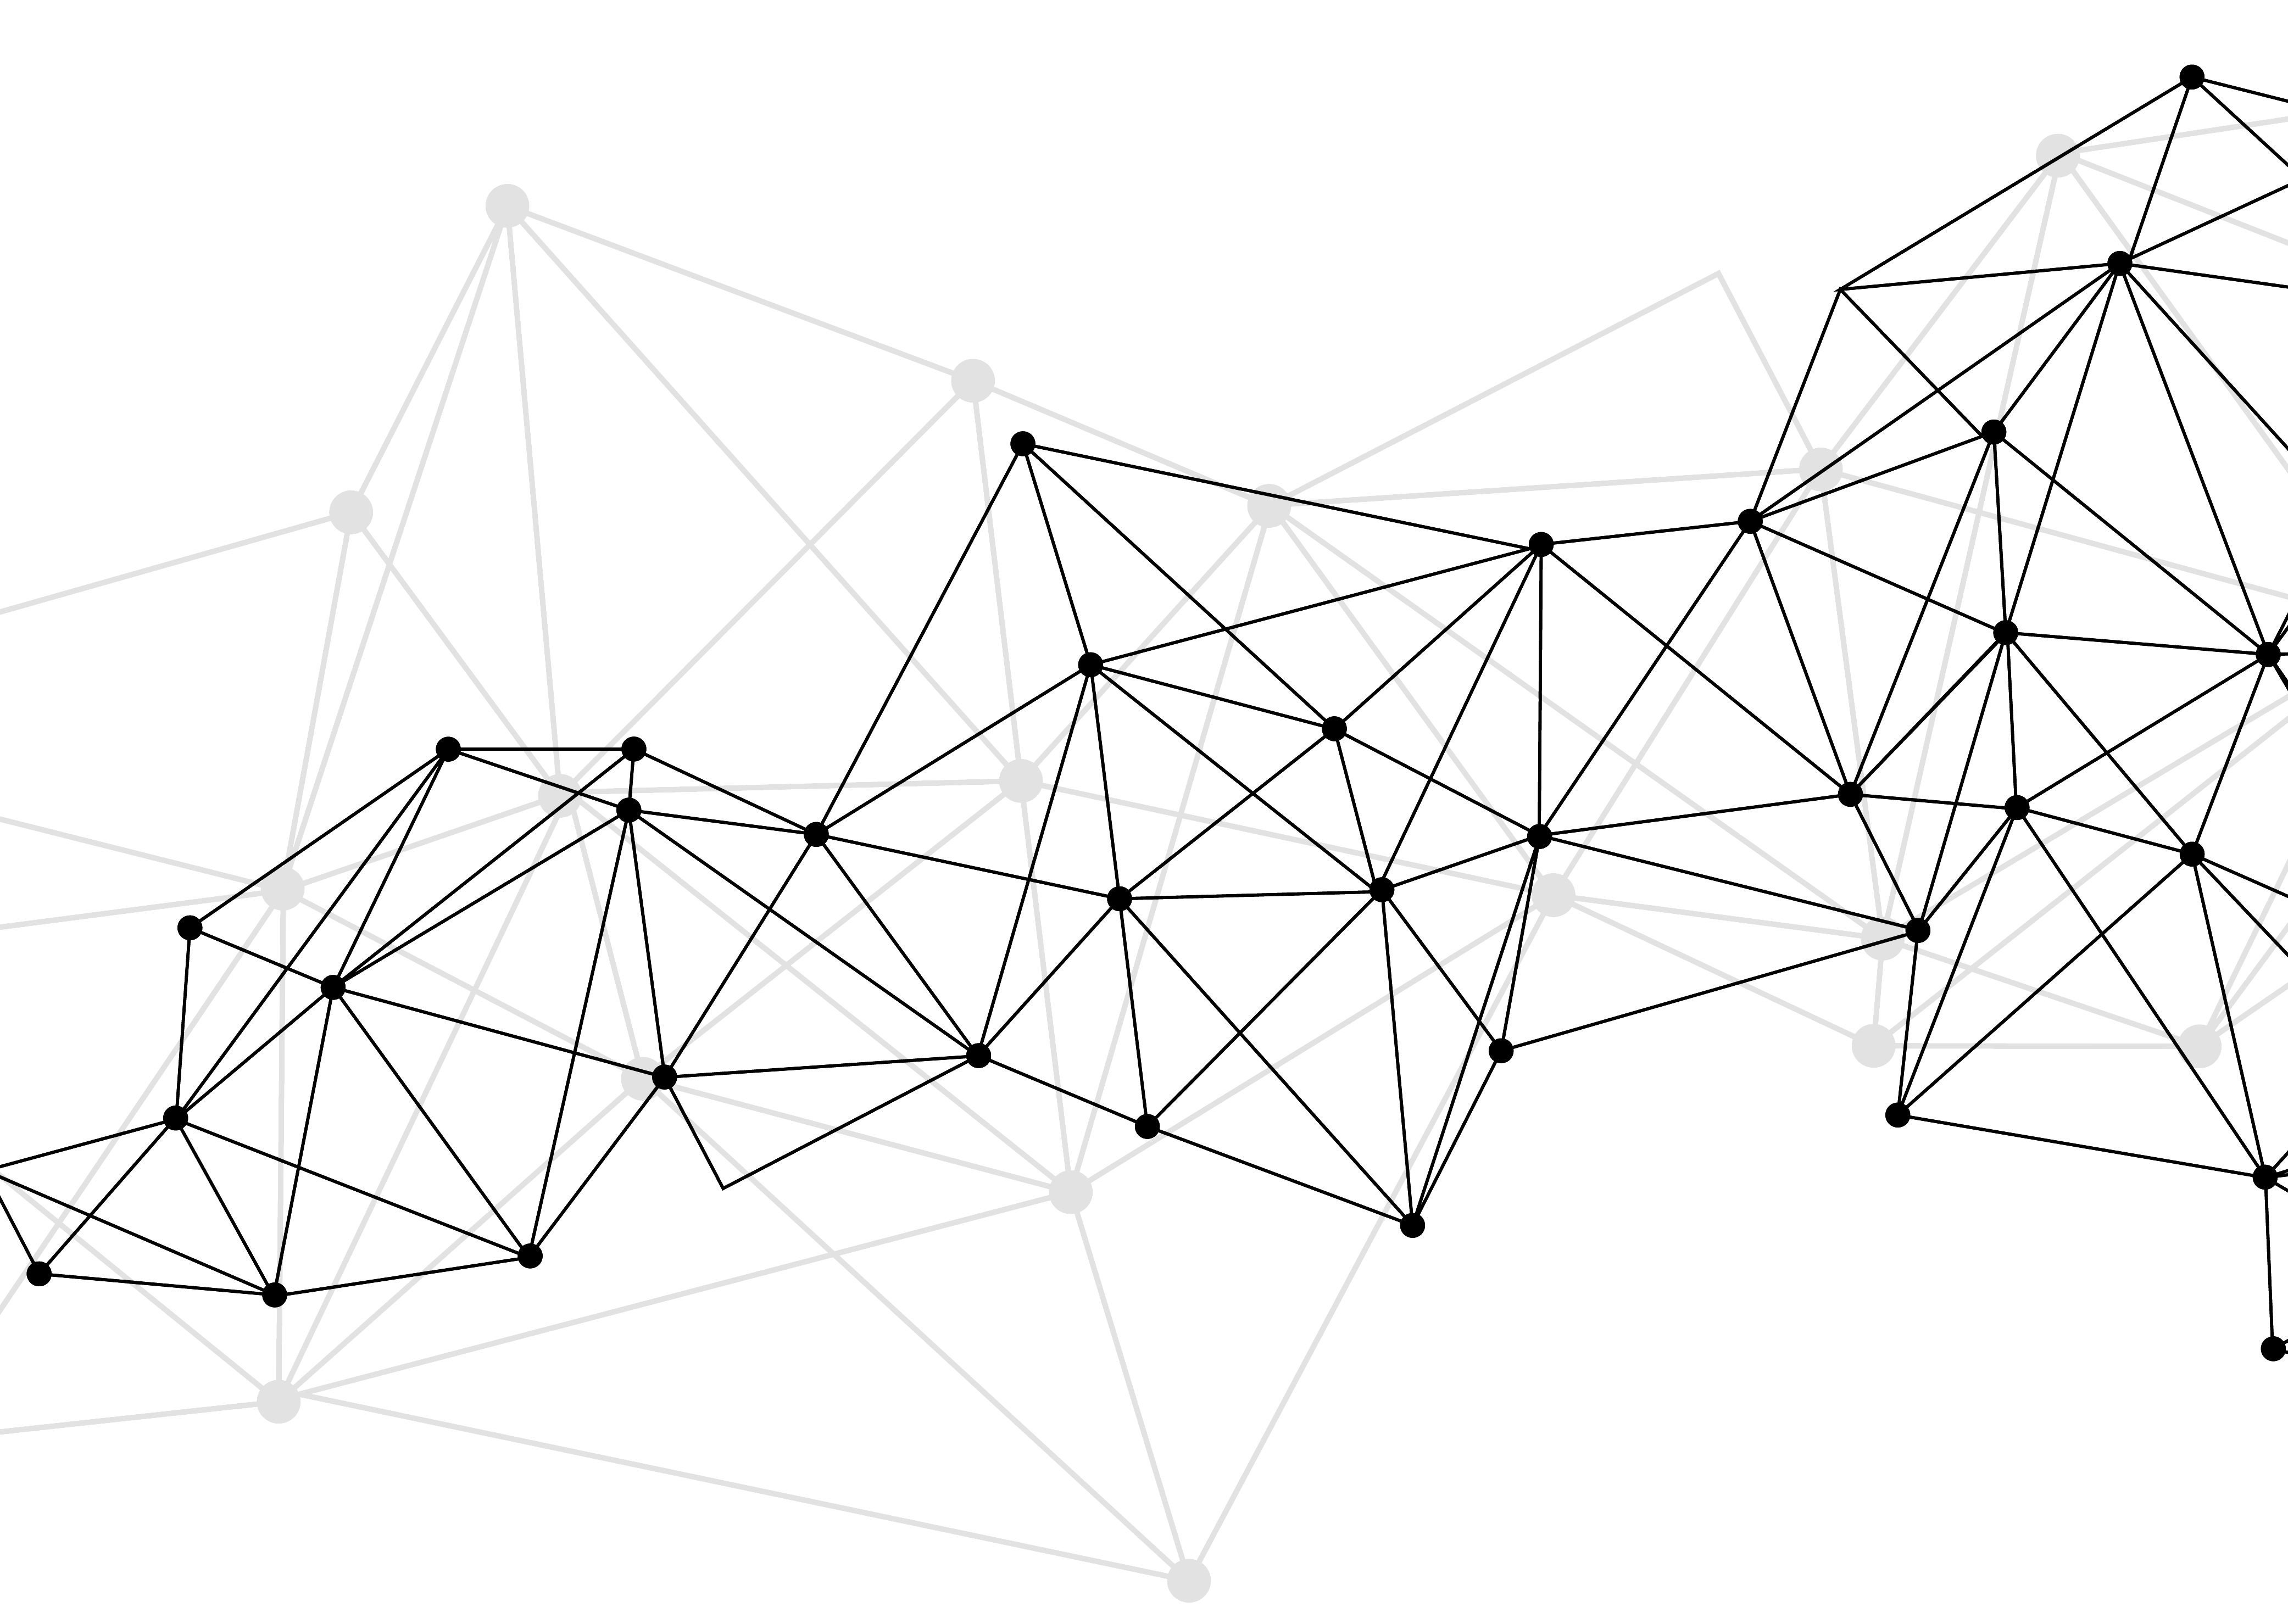
Synonyms
Used for query expansions
User-controlled
Multiple datasets can be included
EMERSE Synonyms
acronyms, abbreviations, professional/consumer terms, misspellings, trade/generic drug names, species, chemo regimens, phrase variations, malapropisms, idioms, neologisms, organizations, companies, & more
2 million unique entries (85% not within UMLS)
http://project-emerse.org/presentations.html

Slide 19
Typical workflow
initial cohort identified
with a cohort discovery
tool using structured data (or via EMERSE
‘Find Patients’)
Cohort discovery tools:
i2b2/ENACT, Leaf, etc.
http://project-emerse.org/presentations.html

Slide 20
Typical workflow
additional details abstracted from the free text using EMERSE
http://project-emerse.org/presentations.html

Slide 21
Typical workflow
Data recorded in an electronic data capture system (e.g., REDCap)
http://project-emerse.org/presentations.html

Slide 22
Publications using EMERSE
620
papers and abstracts
Full list at:
http://project-emerse.org/publications.html
http://project-emerse.org/presentations.html

Slide 23
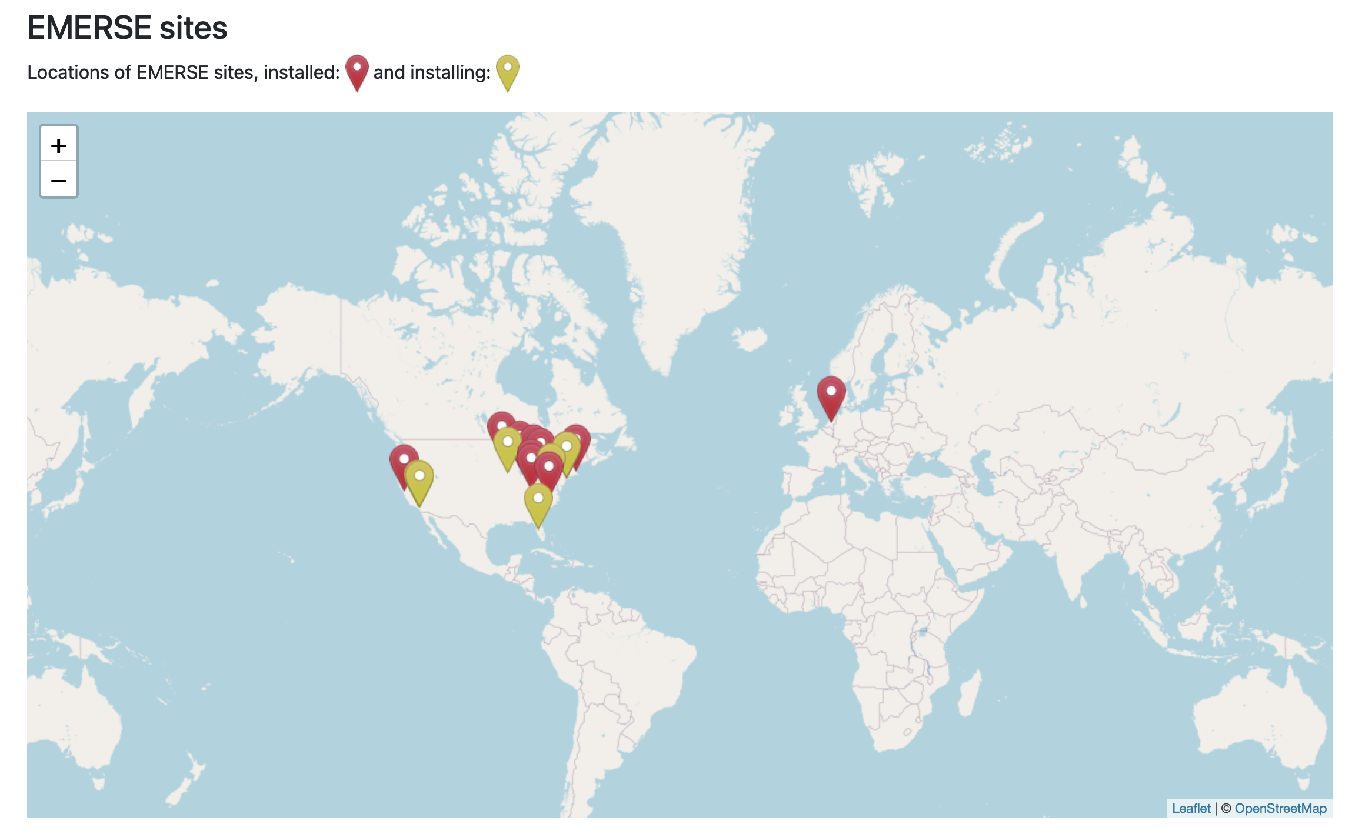
Where is EMERSE?
http://project-emerse.org/presentations.html

Slide 24
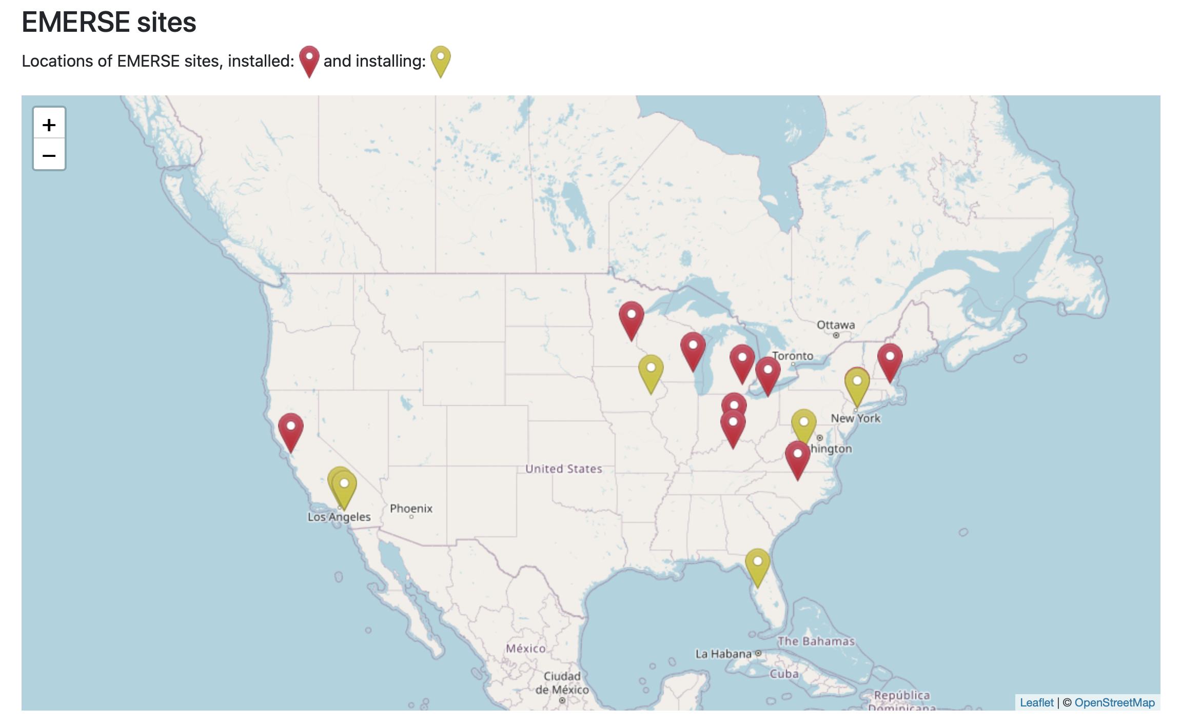
Where is EMERSE?
http://project-emerse.org/presentations.html

Slide 25
EMERSE Research Informatics Network
real-time, secure
cross-site queries
http://project-emerse.org/presentations.html

Slide 26
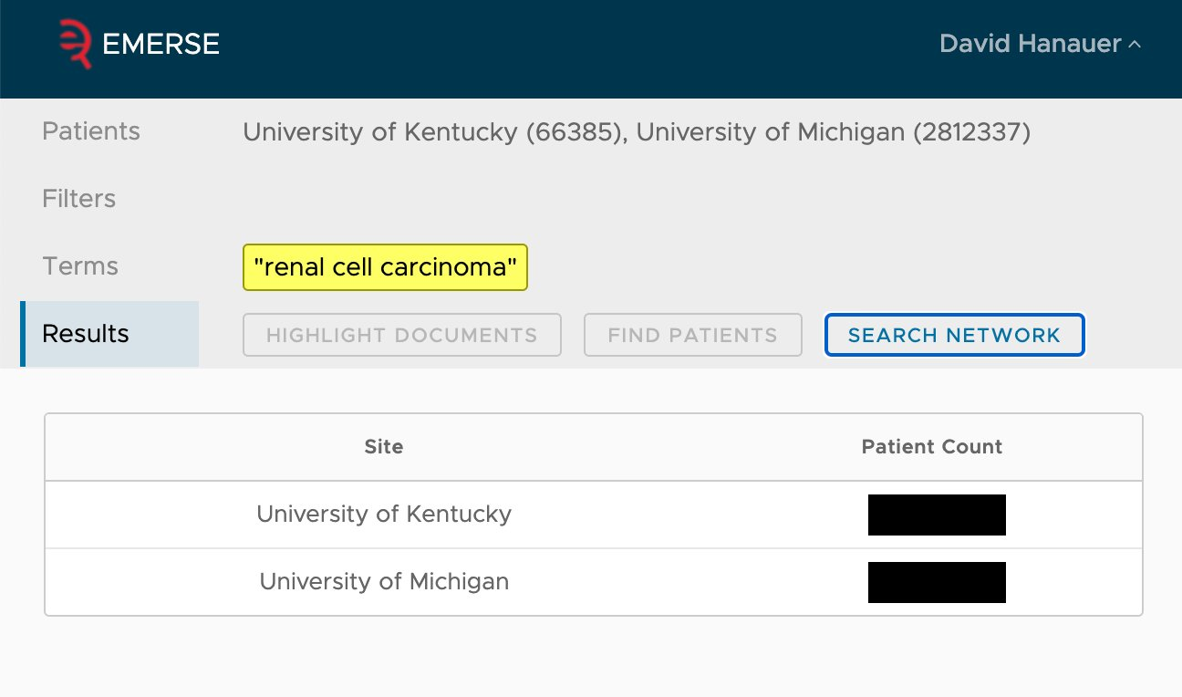
EMERSE Research Informatics Network
http://project-emerse.org/presentations.html

Slide 27
Natural Language Processing (NLP)
Incorporation of NLP features
- negation
- uncertainty
- subject (patient vs other)
- history of
- named entity recognition/mapping to ontologies
(coming soon…)
http://project-emerse.org/presentations.html

Slide 28
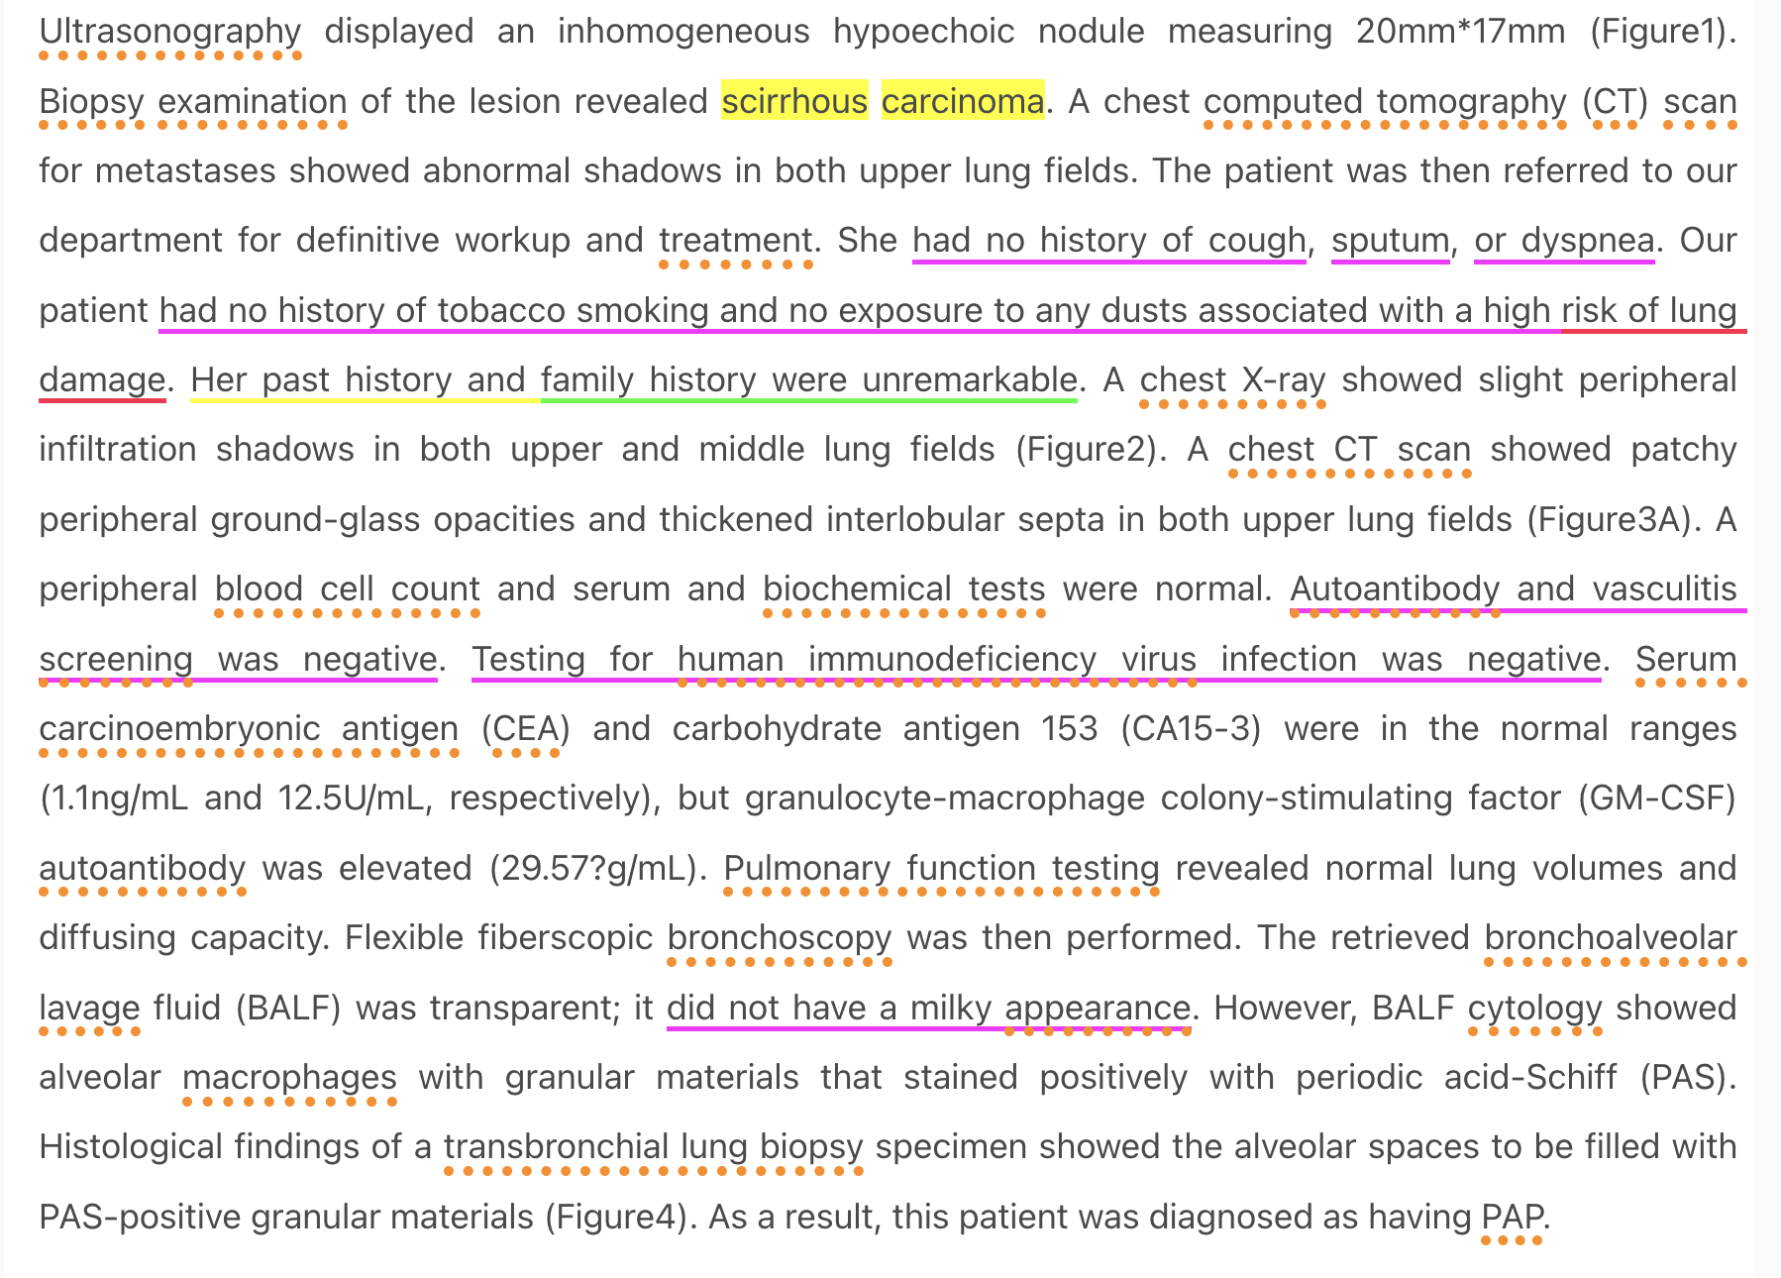
From our NLP proof-of-concept system
https://www.ncbi.nlm.nih.gov/pmc/articles/PMC4140142/
http://project-emerse.org/presentations.html

Slide 29
project-emerse.org
http://project-emerse.org/presentations.html

Slide 30
Twitter: @projectEMERSE
publications
software releases
announcements
webinars
http://project-emerse.org/presentations.html

Slide 31
Interested in learning more?
Contact us to schedule a time with your team for:
Discussions about research strategies
Training
Live demonstrations
http://project-emerse.org/presentations.html

Slide 32
EMERSE-team@umich.edu
Lisa Ferguson
David Hanauer
Kellen McClain
Guan Wang
http://project-emerse.org/presentations.html

